Slide 1
migratED: Migrations and human rights enhanced through Technology in EDucation
Andreas Andreou
andreas@cnti.org.cy
Project coordinator
Co-funded by the Erasmus+ programme
of the European Union

Slide 2
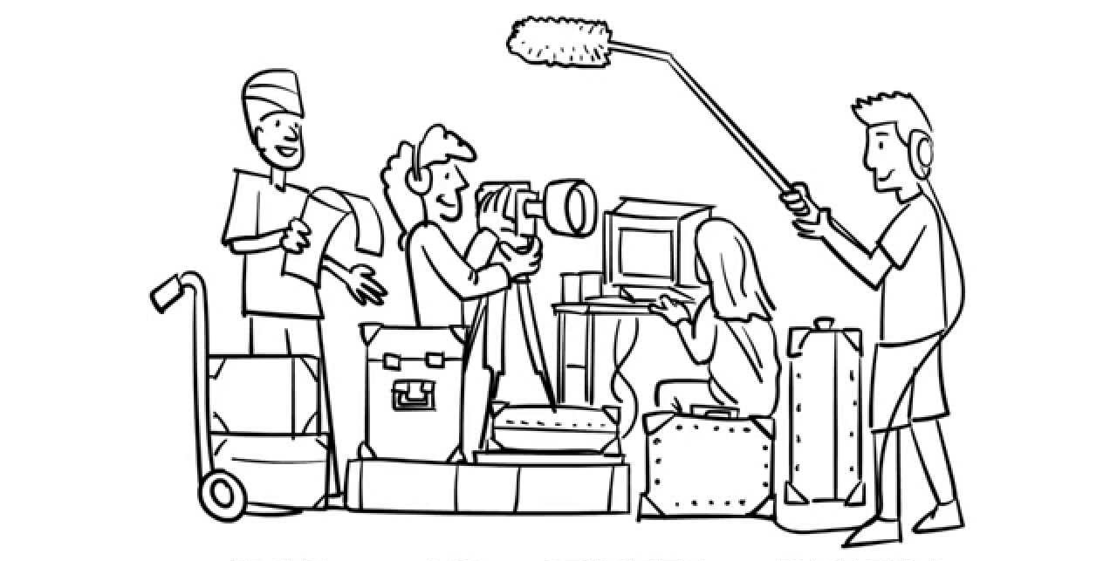

Slide 3
Thanks!
Any questions?
andreas@cnti.org.cy

